Slide 1
Exploring and Managing Data in R
UNIT-2

Slide 2
Table of Contents - Part 1
1. Introduction to Data Exploration in R
2. Understanding Data Frames
3. Creating and Loading Data Frames
4. R Functions for Data Understanding
5. Exploring Data: Structure and Content
6. Summarizing Data
7. Handling Missing Values
8. Invalid Values and Outliers
9. Descriptive Statistics
10. Data Visualization for Spotting Problems
11. Using ggplot2 for Visualization
12. Dealing with Data Types

Slide 3
Introduction to Data Exploration in R
Data exploration helps understand the structure, trends, missing values, and patterns in the dataset.
Example:
Use the iris dataset: data(iris)
View summary: summary(iris)

Slide 4
Understanding Data Frames
Data frames are tabular data structures.
They can store heterogeneous data types.
Data Frames can have different types of data inside it. While the first column can be character, the second and third can be numeric or logical. However, each column should have the same type of data.
Use the data.frame() function to create a data frame:
Example:
df <- data.frame(Name=c('A', 'B'), Age=c(21, 22))
str(df) shows structure

Slide 5
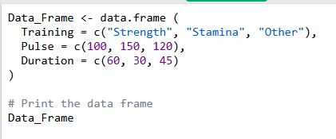
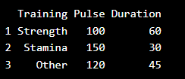
Data Frame Code:
Output:

Slide 6
Other DataFrame commands
summarize the Data--summary(Data_Frame)
Access Items--DataFrame[[“Training”]] or DataFrame[1] or Data_Frame$Training
Add Rows--New<-rbind(Data_Frame,c(“Strength”,110,110)
Add Columns--cbind()
Data Frame length--length(Data_frame)
Combining Data Frames--rbind() & cbind()
refer https://www.w3schools.com/r/r_data_frames.asp

Slide 7
Creating and Loading Data Frames
Create: df <- data.frame(id=1:3, name=c('A','B','C'))
refer https://www.geeksforgeeks.org/pandas/creating-a-pandas-dataframe/
Load from CSV:
df <- read.csv('file.csv')
Use head(df) to see the top rows
Ex: # Load CSV file into a DataFrame
df = pd.read_csv("CardioGoodFitness.csv")
print(df.head())

Slide 8
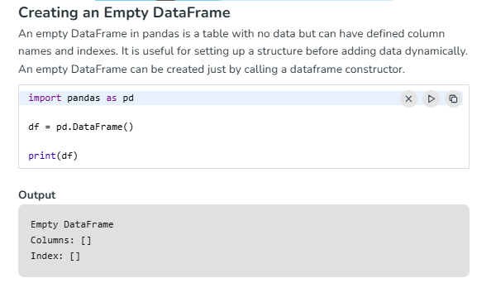

Slide 9
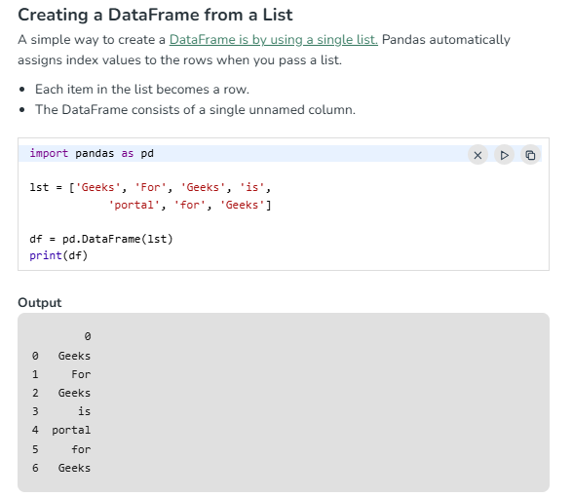

Slide 10
R Functions for Data Understanding
Common functions:
-data(df): loads the dataset
- head(df): first few rows
- str(df): structure
- summary(df): statistical summary
(df =dataset_name)
Example:
summary(mtcars) gives stats for each column
head(mtcars) gives first few rows of mtcars dataset

Slide 11
Exploring Data: Structure and Content
Structure: str(df)
Dimensions: dim(df), nrow(df), ncol(df)
Variable names: names(df)
Example:
df <- mtcars
str(df); names(df)

Slide 12

sample example :
df <- data.frame(
Name = c("Alice", "Bob", "Charlie"),
Age = c(25, 30, 22),
Score = c(90, 85, 88)
)

Slide 13
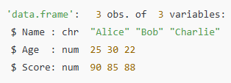
str(df) – Structure of the Data Frame
outputs:
(chr means character, num means numeric)
dim(df) – Get Dimensions--
nrow(df) – Number of Rows-- [1] 3
ncol(df) – Number of Columns--[1] 3
names(df) – Column Names--

Slide 14
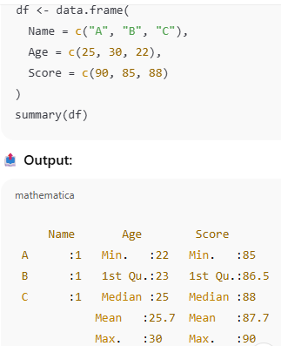
Summarizing Data
Data summarization provides quick statistical insights into each variable — like minimum, maximum, mean, median, etc. It helps understand data distribution and identify potential anomalies.
summary(): Gives basic summary
statistics for each column
- mean, median, min, max
sapply(df, mean):
mean for each column
Example:
sapply(iris[,-5], mean)

Slide 15
Handling Missing Values
Missing data can skew analysis. R offers tools to detect, remove, or replace missing values (NA), allowing you to clean your dataset effectively.
Detect NA: is.na(df)--Checks which elements are NA
Remove NA: df <- na.omit(df)--Removes rows with missing values.
Fill NA: df[is.na(df)] <- 0--Replace NA with value
Example:
df <- data.frame(x=c(1,NA,3)); na.omit(df)

Slide 16
Invalid Values and Outliers
Outliers are extreme values that can distort analysis and model training. Detecting them ensures more accurate insights and better predictive performance.
Outliers: boxplot(df$col)--Visually highlights outliers.
Use IQR Technique to detect:(statistical Method)
Q1 <- quantile(df$col, 0.25)
Q3 <- quantile(df$col, 0.75)
IQR <- Q3-Q1
Outliers: <Q1-1.5*IQR or >Q3+1.5*IQR

Slide 17
Descriptive Statistics
Descriptive statistics summarize the central tendency, dispersion, and shape of a dataset’s distribution. In R, you can calculate mean, median, variance, standard deviation, and interquartile range (IQR) using simple functions.
Mean: mean(df$col)
Median: median(df$col)
SD: sd(df$col)
Example:
var(iris$Sepal.Length), IQR(iris$Sepal.Length)

Slide 18
Examples
Input: x <- c(10, 20, 30, 40)
1. mean(x)--Output: [1] 25
2. median(x)--Output: [1] 25
3. sd(x)--Output: [1] 12.91 (standard deviation)
4. var(x)--Output: [1] 166.67 (Variance is the square of standard deviation)
5. IQR(iris$Sepal.Length)--Output:[1] 1.3 ( It’s the range between the 25th and 75th percentile (Q3 - Q1).

Slide 19
Spotting Problems in Data with Visualisation
Visualisation helps understand large datasets better than plain text or numbers.
·Graphs reveal peaks, sub-populations, and outliers in the data.
Example: A density plot of customer age can show which age group is most common.
It provides clarity by showing values from the lowest to the highest range.
Effective visualisation depends on correct aspect ratio and data scaling.
Enhances decision-making by presenting maximum information visually.

Slide 20
Understanding Data Distribution Using R Visualisation
R visualisation helps identify distribution shape, peak values, and data spread.
Figures show unimodal (single peak) and bimodal (two peaks) distributions for age data.
Majority of customers fall in the 38–64 age range, with a mean age ~51.7.
Multimodal distributions suggest presence of distinct sub-groups in data (e.g., ages 20–30 and 70+).
Basic regression techniques (like linear/logistic) may not handle such complex distributions well.
Histograms are often preferred over density plots for clear and simple representation.

Slide 21
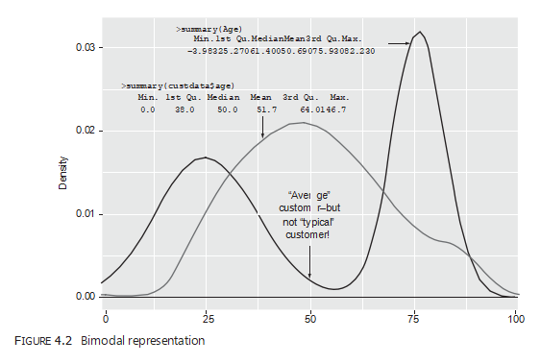

Slide 22
Data Visualization for Spotting Problems
Histograms: hist(df$col)
Density Plots: plot(density(x)), where x is a numeric vector value.
Bar Charts: barplot(H, xlab, ylab, main, names.arg, col)
Example:
hist(iris$Sepal.Width)

Slide 23
Histograms
A histogram shows how numerical data is distributed across equal intervals (or bins).
Unlike bar charts, histogram bars represent continuous data ranges.
Bar height = frequency of values in that interval.
In R, use the hist(x) function to create histograms for numeric vectors.
Full syntax: hist(v, main, xlab, xlim, ylim, breaks, col, border)
Key arguments define titles, axes, range, bin size, and color settings.

Slide 24
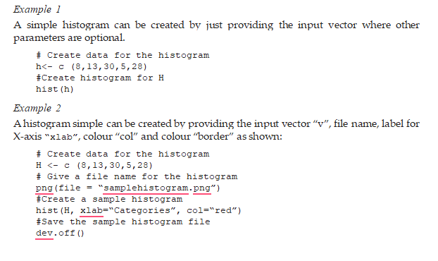

Slide 25
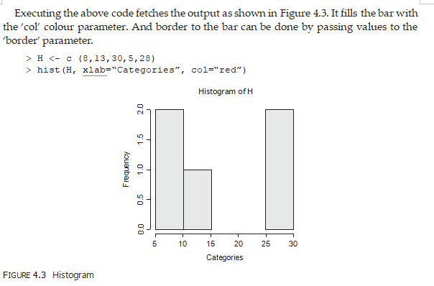
Output for Example-2

Slide 26
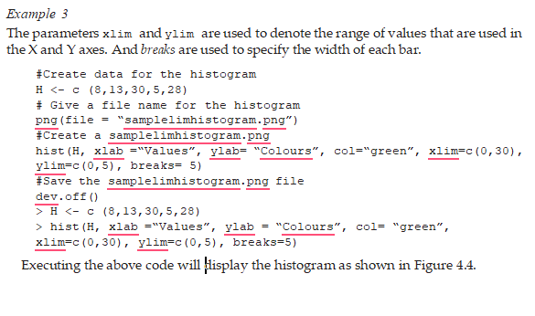

Slide 27
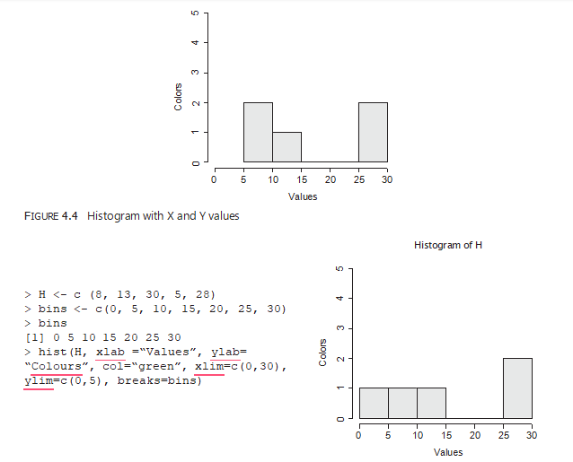
Output for Example-3

Slide 28
Density Plots
A density plot is like a smooth, continuous version of a histogram.
The area under the curve = 1, representing the entire data distribution.
Each point on the curve shows the fraction (or probability) of values at that point.
Useful for understanding the shape and parametric nature of the data.
In R, use plot(density(x)) to create a density plot, where x is a numeric vector.
Ideal for comparing distributions or identifying skewness and multimodal patterns.

Slide 29
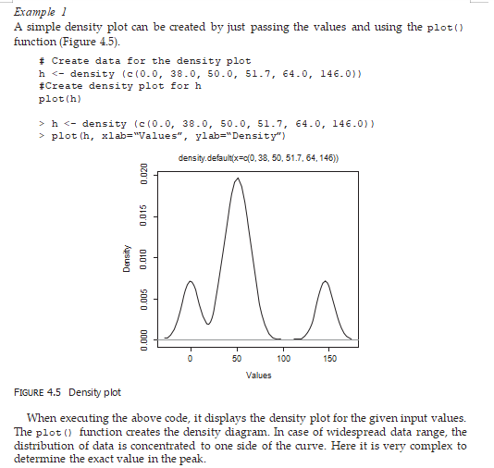

Slide 30
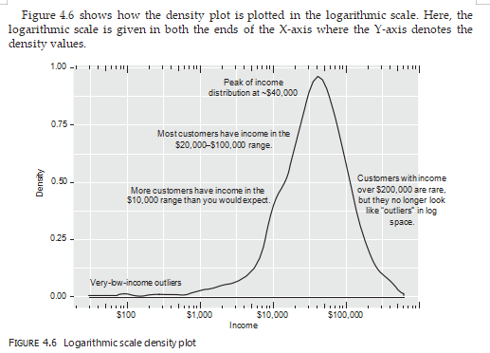
Example 2 In case of non-negative data, another way to plot the curve is using the distribution diagram on a logarithmic scale, which is equivalent to the plot the density plot of log10 (input value). For Figure 4.5 it is very hard to find out the peak value of the mass distribution. Hence, in order to simplify the visual representation log10 scale is used. In Figure 4.6 the peak value of the income distribution is clearly pictured as ~$40,000. In case of wide spread data this logarithmic approach can give a perfect result.

Slide 31
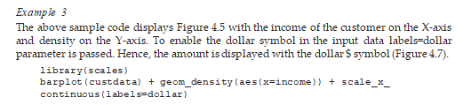

Slide 32
Bar Charts
A bar chart displays data using vertical or horizontal bars proportional to values.
In R, use the barplot() function to create bar charts.
Syntax: barplot(H, xlab, ylab, main, names.arg, col)
H is a vector or matrix of values; col assigns bar colors; names.arg labels each bar.
Common types of bar charts in R:
1. Simple Bar Chart
2. Grouped Bar Chart
3. Stacked Bar Chart
Ideal for categorical data comparison and visual summarization.

Slide 33
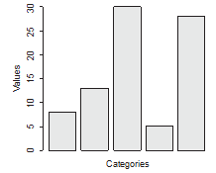
1. Simple Bar Chart
A simple bar chart is created by just providing the input values and a name to the bar chart. The following code creates and saves a bar chart using the barplot() function in R.
Example 1
# Create data for the bar chart
H <- c (8,13,30,5,28)
#Give a name for the bar chart
png(file = “samplebarchart.png”)
#Plot bar chart using barplot() function
barplot(H)
#Save the file
dev.off()
>H <- c (8,13,30,5,28)
>barplot (H, xlab = “Categories”, ylab=“Values”, col=“blue”)

Slide 34
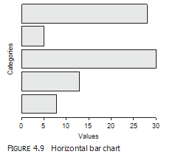
The bar chart is drawn horizontally by passing the “horiz” parameter TRUE. This can be shown with a sample program as follows:
# Create data for the bar chart
H <- c (8,13,30,5,28)
#Give a name for the bar chart
png(file = “samplebarchart.png”)
#Plot bar chart using barplot() function
barplot(H, horiz=TRUE))
#Save the file
dev.off()
>barplot(H, xlab = “Values”, ylab=“Categories”, col=“blue”, horiz=TRUE)

Slide 35
2.Group Bar Chart
A group data in R is used to handle multiple inputs and takes the value of the matrix. This group bar chart is created using the barplot() function and accepts the matrix inputs.

Slide 36
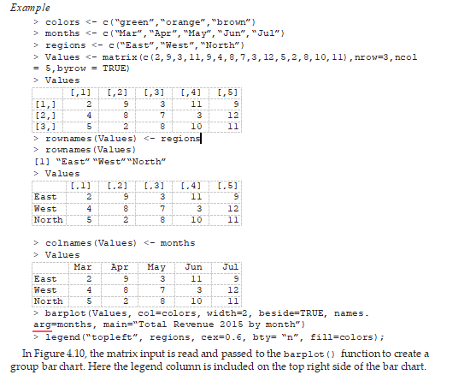

Slide 37
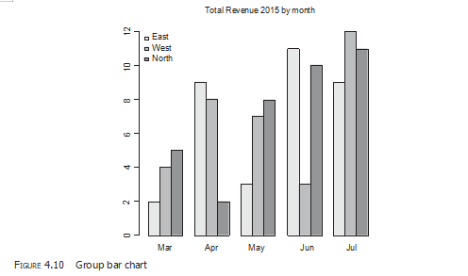
Result

Slide 38
3.Stacked Bar Chart
Stacked bar chart is similar to group bar chart where multiple inputs can take different graphical representations. Except by grouping the values, the stacked bar chart stacks each bar one after the other based on the input values.

Slide 39
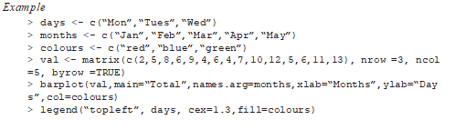
Example

Slide 40
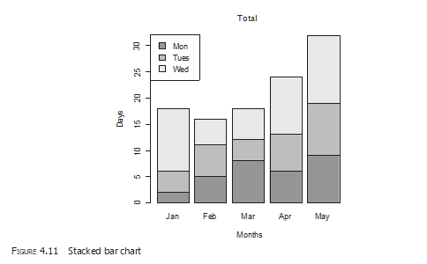
Result
In Figure 4.11, the ‘Total’ is set as the main title of the stack bar chart with ‘Months’ as the X-axis label and ‘Season’ as the Y-axis label. The code legend (“topleft”, days,
cex=1.3,fill=colours) specifies the legend to be displayed at the top right of the bar chart with colours filled accordingly.

Slide 41
Using ggplot2 for Visualization
ggplot2 is a powerful package:
Example:
library(ggplot2)
ggplot(iris, aes(x=Species, y=Sepal.Length)) + geom_boxplot()

Slide 42
Dealing with Data Types
Check: class(df$col), typeof(df$col)
Convert:
as.numeric(), as.character(), as.factor()
Example:
df$col <- as.factor(df$col)

